Slide 1

Data doctors
A deep insight into the covid-19 outlook up until today

Slide 2



Who we are …
Alexandros Rammos
Aspiring data –Business Analyst
Eleftherios Morits
Consultant
Our Moto is . . .
Torture the data and they will confess everything

Slide 3
Introduction
In the face of the ongoing global pandemic, our team Data Doctors has been dedicated to unraveling key patterns and trends within COVID-19 data. Today, we'll take you through our comprehensive analysis, covering two distinct data sets, employing advanced Exploratory Data Analysis (EDA) techniques in Python, and presenting our findings through a powerful Business Intelligence (BI) dashboard.

Slide 4

Data Sources
Covid-19 Dataset
Kaggle
The dataset was provided by the Mexican government.The raw dataset consists of 21 unique features and 1,048,576 unique patients. I
The complete Our World in Data COVID-19 dataset
Our World in Data
COVID-19 dataset with cases, deaths, ICU/hospitalization metrics, testing, vaccination details, and socio-economic factors, organized by location and date.

Slide 5
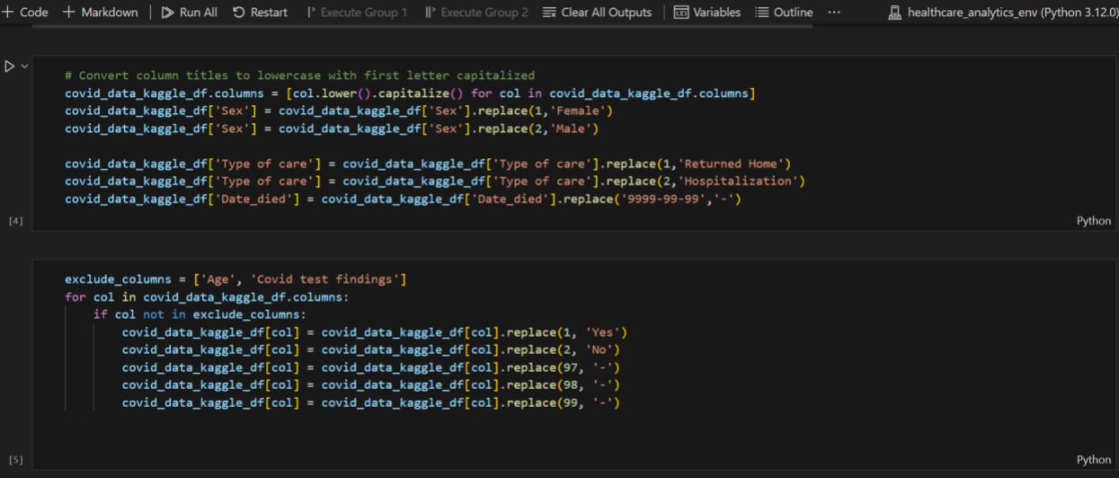



Exploratory Data Analysis (EDA) in Python
Covid-19 Dataset & Our World in Data

Slide 6
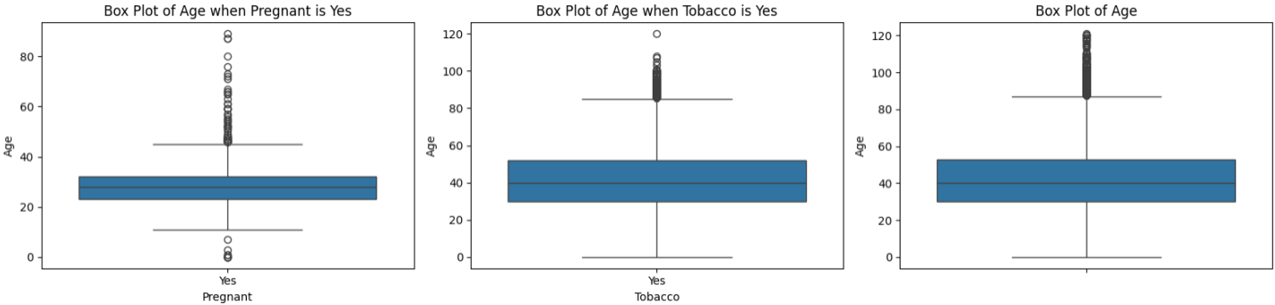
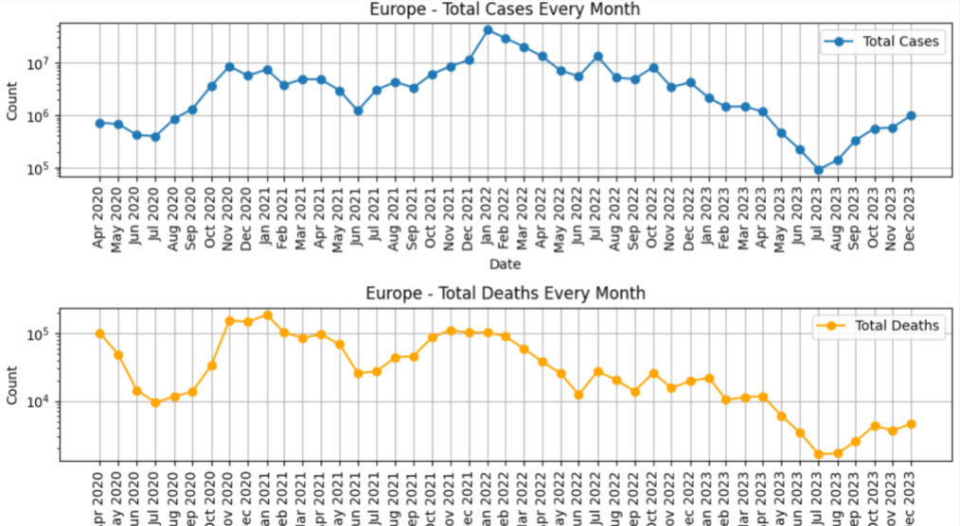
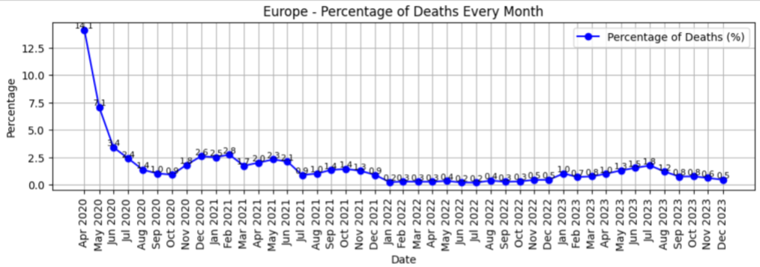
Exploratory Data Analysis (EDA) in Python
Covid-19 Dataset
Outliers' detection in ages and removal
Segmentation of ages
Our World in Data
Removal of null values and redundant columns
Findings per continent

Slide 7

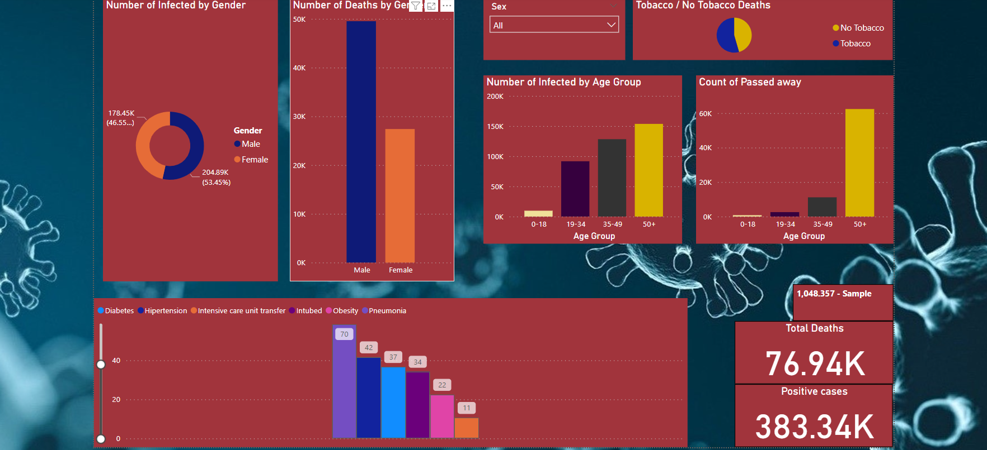
Business Intelligence (BI) Dashboard

Slide 8
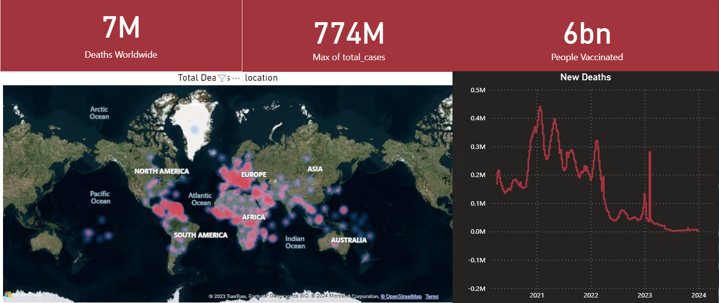
Business Intelligence (BI) Dashboard

Slide 9
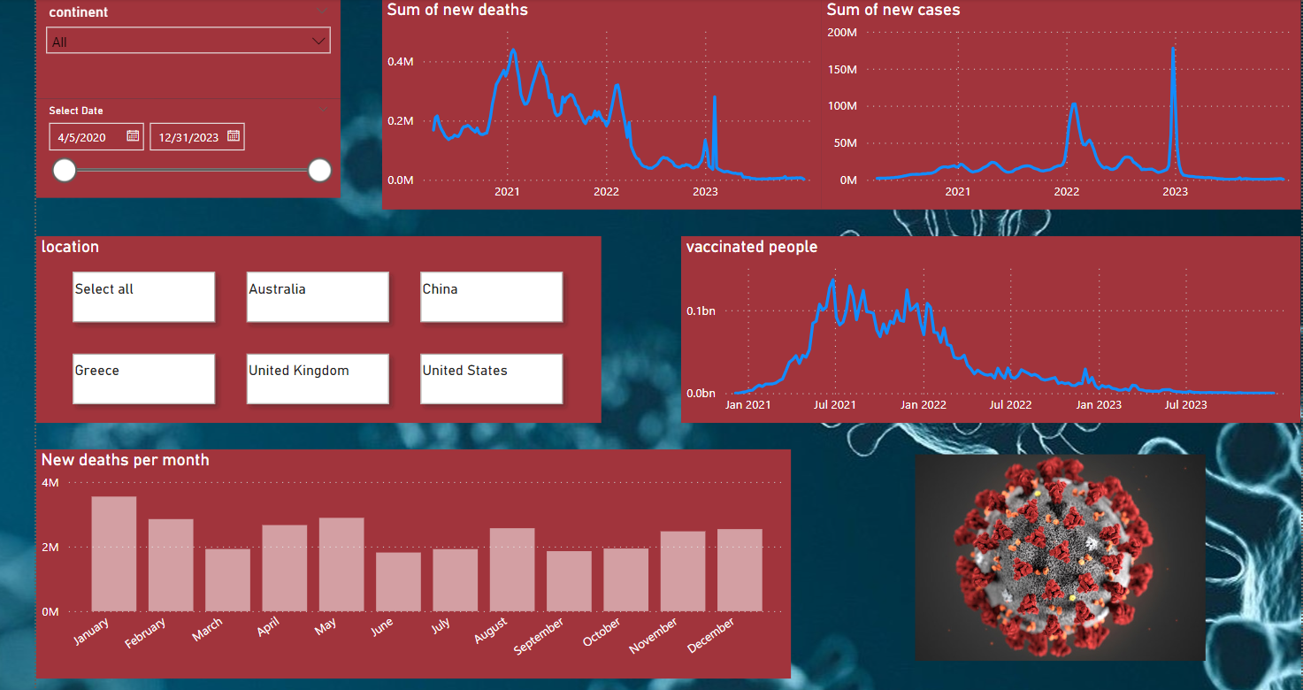
Business Intelligence (BI) Dashboard

Slide 10

Key Findings
Variables affecting COVID mortality
Genre : Males exhibit much higher mortality
Age Group :Individuals aged 50 + face significantly higher risks compared to younger age groups.
Diseases: We've observed that the presence of pneumonia, and diabetes, is associated with a mortality risk exceeding 70% in COVID cases.
In summary, it is evident that an increased number of new COVID cases occurs during the winter and spring, with a significant peak in 2021 leading to the highest mortality rates.
Due to widespread vaccination 6bn, there has been a notable reduction in both the occurrence of new COVID cases and the number of deaths
Notes:
Stay as far away as possible from others when coughing or sneezing; better yet, face away from them. Sneeze into the crook of your arm or into a paper handkerchief that you then throw away immediately. Avoid touching other persons when greeting them and wash your hands regularly and thoroughly for at least 20 seconds with soap and water.

Slide 11



Let’s connect on LinkedIn
Alexandros Rammos Eleftherios Morits

Slide 12
Q&A
Alexandros Rammos Eleftherios Morits

